Slide 1
Engineer our Classroom!
WELCOME TO OPEN HOUSE 2023!
5-S.T.E.A.M.
Ms. Sapra
ksapra@yonkerspublicschools.org

Slide 2
AGENDA
CLASS PHILOSOPHY
LOGIN TO CLASS PAGE
ASSIGNMENTS
GRADING & POWERSCHOOL
Type to enter a caption.
9/17/20

Slide 3
Benefits of Engineering in the Classroom
There are many benefits to incorporating engineering activities in the classroom. Engineering:
Encourages students to utilize higher order thinking skills
Allows students to apply what they have learned in other subject areas
Encourages creativity and innovation
Is interdisciplinary
Facilitates cooperative learning and teamwork
Is intrinsically motivating and engaging!

Slide 4
Bloom’s Revised Taxonomy of Educational Objectives
Higher-order skills
Creating
Evaluating
Analyzing
Applying
Understanding
Remembering
Lower-order skills
Bloom et al., 1956 ; Anderson and Krathwohl, 2001

Slide 5
What is the Engineering Design Process?
In class we will apply the engineering design process (EDP) which is a multi-step process used by engineers to efficiently create solutions to complex problems

Slide 6
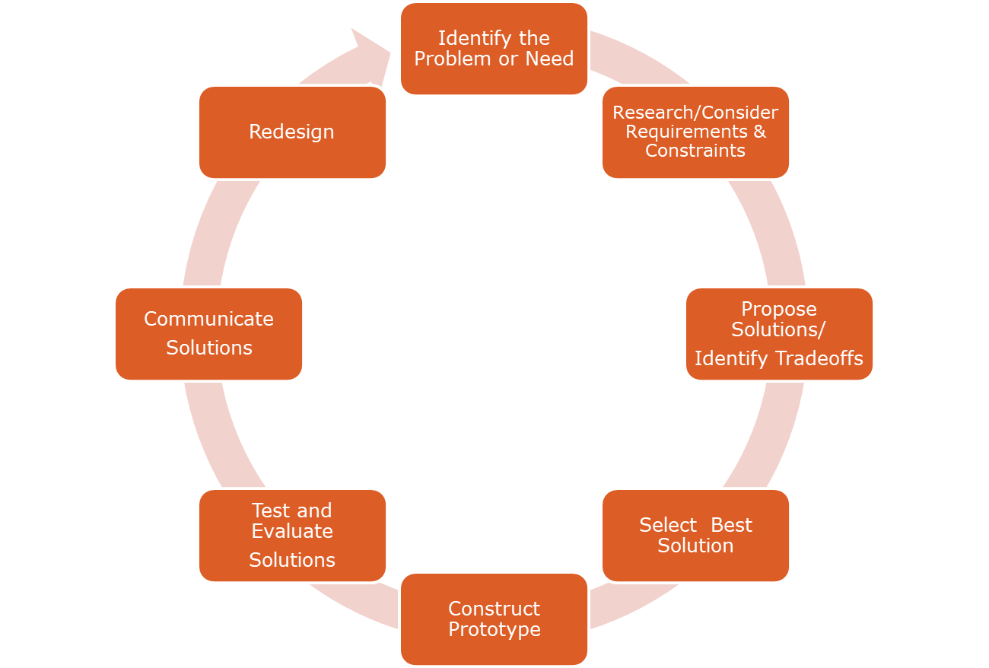
Engineering Design Process
Adapted from Massachusetts Department of Education, Technology/Engineering Curriculum Frameworks - Spring 2006

Slide 7
THE FLIPPED CLASSROOM
9/17/20

Slide 8
MS. SAPRA’S CLASS PAGE Check for what your child is experiencing daily in class!
CLASS PAGE
Select the Teachers Tab
Find my name and click
ASSIGNMENT Tab on the left gives you the work we are covering
9/17/20

Slide 9
IF ABSENT:
Keep up with all assignments
Check your Class Page daily
Check your messages in TEAMs & CLEVER regularly
Message Ms. Sapra if you have any questions

Slide 10
Thank You!
5TH Grade PARENTS for the support of your ENGINEERING CHILD!

